Slide 1
The Leading Thinkers from the “One Hundred Schools” of the Late Zhou Dynasty

Slide 2
Big Questions of the Times
Why is this world so chaotic?
How does one find stability for the individual? For society?
What is the “good life”?
Note: No one (at this time) asked for the “meaning” of life.

Slide 3
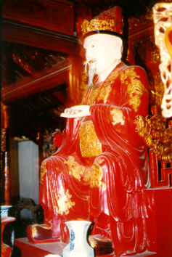
Confucius (551-479 BCE)
Ren 仁: "human-ness," benevolence
The natural order of things is a moral order.
Li 禮: ritual that reveals the natural order

Slide 4
Confucius’s Answer
A return to virtue. Confucius’s main principle was moral goodness and its power to transform society. This notion reflected Confucius’s conviction that:
There was a potential for perfectibility in human nature.
Criterion for goodness was righteousness as opposed to profit.
Confucius’s prescription for the family
Filial piety.
Confucius’s prescription for society
The proper observance of ritual.

Slide 5
What Confucius didn’t offer
No mysticism: Confucius' feelings toward spirit world are ambivalent.
No hell, no sanctions, no devils and no gods.
No explanation of the big "life" questions, matters all focused on human social relations.

Slide 6
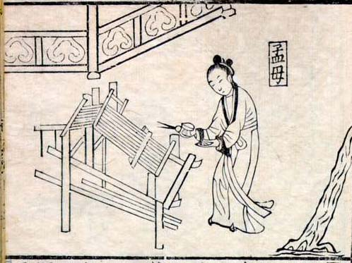
Mencius (372-289 BCE)
Yi 義: "ritual" propriety in personal behavior
Right Relationships: father-son, subject-ruler, husband-wife, elder brother-younger brother, and friend-friend
Humankind is born good.
People have the right to overthrow cruel leaders.

Slide 7
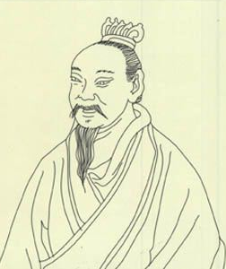
Mozi 墨子 (479-381 BCE)
Born Mo Di墨翟 , Mozi lived between Confucius's death and Mencius's birth.
Successful in the promotion of his philosophical system in his own lifetime.
Acceptance of Mohist ideas waned after the founding of the Qin dynasty (221-206 BCE)

Slide 8
Mohists’ Perceived Problems in Zhou Society
Critical of Confucians as pretentious aristocrats, opposed Confucian skeptics regarding the spirit world, tendency toward fatalism, and preoccupation with ritual.
Opposed all forms of offensive warfare.

Slide 9
Main Principle of Mohism
Universal Love (Boai 博愛) vs. "Graded Love"
Unity of Thought and Action
Obey Rulers for the Common Good

Slide 10

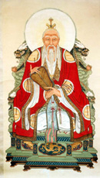
Laozi 老子 (c. 500 BCE)
The Way (Dao道) cannot be described.
道可道非常道 (Dào kě dào fēicháng dào)
“The Way that may be spoken of is not the Way.”
Wu wei 無為: "effortlessness" as a political strategy.

Slide 11
Daoism’s Problems with Confucianism
Saw the virtue promoted by Confucian gentlemen as the accidental source of evil and sorrow in the world.
Argued that human moral ideas reflect human depravity, filial piety springs from impiety; Confucian rules of propriety reflect the world's moral disorder.

Slide 12
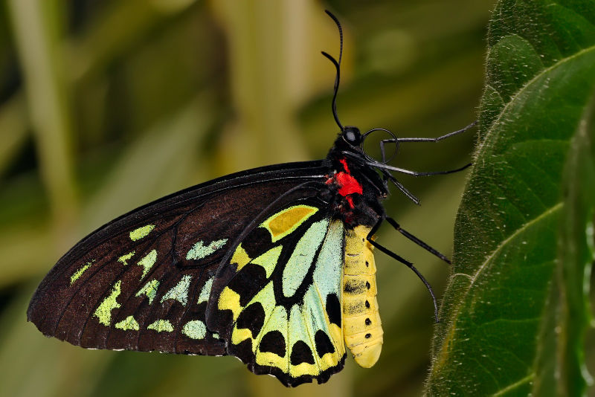
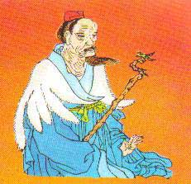
Zhuangzi 莊子 (died c. 329 BCE)
Focus more on the individual.
The only constant is change itself.
One should neither reform things in life nor keep them the same. Instead, one should rise above them.

